Slide 1

Reading
Making a difference
https://www.youtube.com/watch?v=N1W-1oBTLLE

Slide 2
How can you make a difference in the world?
I can make a difference in different ways. For example, I can…

Slide 3
Reading Strategies

Slide 4
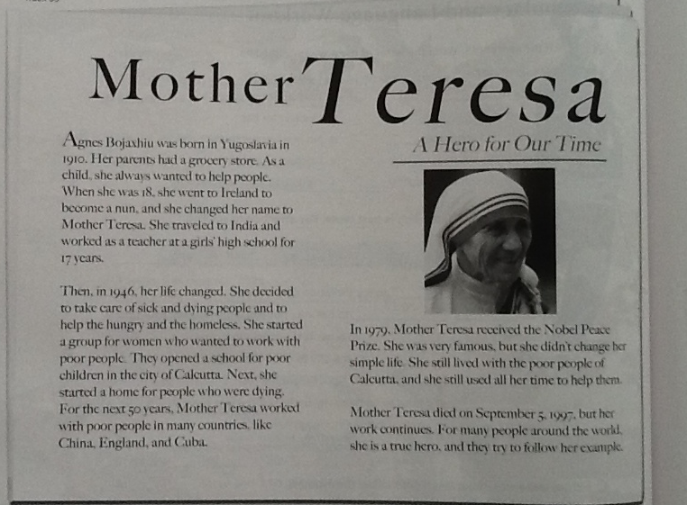
What things can you do when you are reading or looking for information in a reading?

Slide 5
Ex A:
Scan the article look at the pictures, the title and 6 countries mentioned in the reading. What do you know about them?

Slide 6
Ex B:
Scan the article and complete the chart.

Slide 8

Make a list of 5 things you can do to make a difference
Smile at someone
Give a hug and say thank you.
Buy a small chocolate a give it to someone to make that person smile ☺
Make my bed and clean the house.
Visit an orphanage.

